Slide 1
Storing Lists in LDMSD

Slide 2
Outlines
List and record APIs useful for storage plugins
Storage supports for lists and records without the decomposition feature
Supported lists
How store_sos and store_csv store lists
Lists of singletons
Lists of arrays
Lists of records
Multiple lists
Example of storing procstat2

Slide 3
List and record APIs useful for storage plugins

Slide 4
Access list entries
Get a list handle
ldms_mval_t lh = ldms_metric_get(ldms_set_t set, int list_metric_id)
Get the list length
size_t len = ldms_list_len(ldms_set_t set, ldms_mval_t lh)
Iterate thru a list
ldms_mval_t ent = ldms_list_first(ldms_set_t set, ldms_mval_t lh, enum ldms_value_t type *ent_type, size_t *ent_count)
lh is the list handle.
ent_type is an output that is the entry’s value type.
ent_count is an output that is the array length if the list entry is an array. Otherwise, the value is 1.
ldms_mval_t next = ldms_list_next(ldms_set_t set, ldms_mval_t ent, enum ldms_value_t type *next_type, size_t *next_count)
ent is the handle of the previous list entry.

Slide 5
Work with ldms_mval_t of primitive types
Singletons
ldms_mval_get_###(ldms_mval_t mval)
uint64_t v = ldms_mval_get_u64(ldms_mval_t mval)
Arrays
ldms_mval_array_get_###(ldms_mval_t mval, int idx)
idx is an array index, starting from 0.
double v = ldms_mval_array_get_double(ldms_mval_t mval, int idx)
The APIs are new.
Analogous to ldms_metric_get_###() and ldms_metric_array_get_###()
Notes:
ldms_metric_get_u64()

Slide 6
Work with records in a list
Get the record handle in a list
ldms_mval_t rec = ldms_list_first(set, lh, &rec_type, &rec_count)
ldms_mval_t rec = ldms_list_next(set, rec, &rec_type, &rec_count)
rec_type is LDMS_V_RECORD_INST.
rec_count is 1.
Get the record cardinality
int card = ldms_record_card(ldms_mval_t rec)
Return -EINVAL if rec is not a record instance.

Slide 7
Access a record entry
ldms_mval_t ent = ldms_record_metric_get(ldms_mval_t rec, int i)
enum ldms_value_type type = ldms_record_metric_type_get(ldms_mval_t rec, int i, size_t *count)
rec is the record handle.
i is the index in the record.
count is an output that is the array length if the entry is an array.
ldms_record_get_###(ldms_mval_t rec, int i)
ldms_record_array_get_###(ldms_mval_t rec, int i, int idx)
idx is the array element index.
uint64_t v = ldms_record_get_u64(rec, 0);
uint64_t v = ldms_record_array_get_u64(rec, 0, 0);

Slide 8
Code example

Slide 9
Example how to use the APIs
There is only one list.
A list is stored in multiple rows.
Pseudo-code
foreach (entry in list); do row = new(); foreach (metric in set); do if (metric.type() == LIST); do row.append(entry); else row.append(metric); store(row);
Notes:
An Example how to use the APIs

Slide 10
int store(ldmsd_store_handle_t sh, ldms_set_t set, int *metric_arry, size metric_count) { int list_mid = my_store_find_list(set, metric_arry, metric_count); ldms_mval_t lh = ldms_metric_get(set, list_mid); /* For each list entry */ for (lent = ldms_list_first(set, lh, &ltype, &lcount); lent; lent = ldms_list_next(set, lent, &ltype, &lcount)) { /* for each metric */ for (i = 0; i < metric_count; i++) { metric_name = ldms_metric_name_get(set, metric_arry[i]); type = ldms_metric_type_get(set, metric_arry[i]); mval = ldms_metric_get(set, metric_arry[i]); cnt = ldms_metric_array_get_len(set, metric_arry[i]); switch (type) { case LDMS_V_RECORD_INST: assert(0 == “Impossible”); /* Records must be in a list. */ case LDMS_V_RECORD_TYPE: continue; /* Record definition, skip */ case <primitive>: store_mval(mval, type, cnt); break; case LDMS_V_LIST: store_mval(lent, ltype, lcount); break; default: assert(0); } } } }

Slide 11
int store(ldmsd_store_handle_t sh, ldms_set_t set, int *metric_arry, size metric_count) { int list_mid = my_store_find_list(set, metric_arry, metric_count); ldms_mval_t lh = ldms_metric_get(set, list_mid); /* For each list entry */ for (lent = ldms_list_first(set, lh, &ltype, &lcount); lent; lent = ldms_list_next(set, lent, &ltype, &lcount)) { /* for each metric */ for (i = 0; i < metric_count; i++) { metric_name = ldms_metric_name_get(set, metric_arry[i]); type = ldms_metric_type_get(set, metric_arry[i]); mval = ldms_metric_get(set, metric_arry[i]); cnt = ldms_metric_array_get_len(set, metric_arry[i]); switch (type) { case LDMS_V_RECORD_INST: assert(0 == “Impossible”); /* Records must be in a list. */ case LDMS_V_RECORD_TYPE: continue; /* Record definition, skip */ case <primitive>: store_mval(mval, type, cnt); break; case LDMS_V_LIST: store_mval(lent, ltype, lcount); break; default: assert(0); } } } }

Slide 12
int store(ldmsd_store_handle_t sh, ldms_set_t set, int *metric_arry, size metric_count) { int list_mid = my_store_find_list(set, metric_arry, metric_count); ldms_mval_t lh = ldms_metric_get(set, list_mid); /* For each list entry */ for (lent = ldms_list_first(set, lh, &ltype, &lcount); lent; lent = ldms_list_next(set, lent, &ltype, &lcount)) { /* for each metric */ for (i = 0; i < metric_count; i++) { metric_name = ldms_metric_name_get(set, metric_arry[i]); type = ldms_metric_type_get(set, metric_arry[i]); mval = ldms_metric_get(set, metric_arry[i]); cnt = ldms_metric_array_get_len(set, metric_arry[i]); switch (type) { case LDMS_V_RECORD_INST: assert(0 == “Impossible”); /* Records must be in a list. */ case LDMS_V_RECORD_TYPE: continue; /* Record definition, skip */ case <primitive>: store_mval(mval, type, cnt); break; case LDMS_V_LIST: store_mval(lent, ltype, lcount); break; default: assert(0); } } } }

Slide 13
int store(ldmsd_store_handle_t sh, ldms_set_t set, int *metric_arry, size metric_count) { int list_mid = my_store_find_list(set, metric_arry, metric_count); ldms_mval_t lh = ldms_metric_get(set, list_mid); /* For each list entry */ for (lent = ldms_list_first(set, lh, &ltype, &lcount); lent; lent = ldms_list_next(set, lent, &ltype, &lcount)) { /* for each metric */ for (i = 0; i < metric_count; i++) { metric_name = ldms_metric_name_get(set, metric_arry[i]); mval = ldms_metric_get(set, metric_arry[i]); type = ldms_metric_type_get(set, metric_arry[i]); cnt = ldms_metric_array_get_len(set, metric_arry[i]); switch (type) { case LDMS_V_RECORD_INST: assert(0 == “Impossible”); /* Records must be in a list. */ case LDMS_V_RECORD_TYPE: continue; /* Record definition, skip */ case <primitive>: store_mval(mval, type, cnt); break; case LDMS_V_LIST: store_mval(lent, ltype, lcount); break; default: assert(0); } } } }

Slide 14
int store(ldmsd_store_handle_t sh, ldms_set_t set, int *metric_arry, size metric_count) { int list_mid = my_store_find_list(set, metric_arry, metric_count); ldms_mval_t lh = ldms_metric_get(set, list_mid); /* For each list entry */ for (lent = ldms_list_first(set, lh, &ltype, &lcount); lent; lent = ldms_list_next(set, lent, &ltype, &lcount)) { /* for each metric */ for (i = 0; i < metric_count; i++) { metric_name = ldms_metric_name_get(set, metric_arry[i]); mval = ldms_metric_get(set, metric_arry[i]); type = ldms_metric_type_get(set, metric_arry[i]); cnt = ldms_metric_array_get_len(set, metric_arry[i]); switch (type) { case LDMS_V_RECORD_INST: assert(0 == “Impossible”); /* Records must be in a list. */ case LDMS_V_RECORD_TYPE: continue; /* Record definition, skip */ case <primitive>: store_mval(mval, type, cnt); break; case LDMS_V_LIST: store_mval(lent, ltype, lcount); break; default: assert(0); } } } }

Slide 15
int store(ldmsd_store_handle_t sh, ldms_set_t set, int *metric_arry, size metric_count) { int list_mid = my_store_find_list(set, metric_arry, metric_count); ldms_mval_t lh = ldms_metric_get(set, list_mid); /* For each list entry */ for (lent = ldms_list_first(set, lh, &ltype, &lcount); lent; lent = ldms_list_next(set, lent, &ltype, &lcount)) { /* for each metric */ for (i = 0; i < metric_count; i++) { metric_name = ldms_metric_name_get(set, metric_arry[i]); mval = ldms_metric_get(set, metric_arry[i]); type = ldms_metric_type_get(set, metric_arry[i]); cnt = ldms_metric_array_get_len(set, metric_arry[i]); switch (type) { case LDMS_V_RECORD_INST: assert(0 == “Impossible”); /* Record instances must be in a list. */ case LDMS_V_RECORD_TYPE: continue; /* Record definition, skip */ case <primitive>: store_mval(mval, type, cnt); break; case LDMS_V_LIST: store_mval(lent, ltype, lcount); break; default: assert(0); } } } }

Slide 16
int store(ldmsd_store_handle_t sh, ldms_set_t set, int *metric_arry, size metric_count) { int list_mid = my_store_find_list(set, metric_arry, metric_count); ldms_mval_t lh = ldms_metric_get(set, list_mid); /* For each list entry */ for (lent = ldms_list_first(set, lh, &ltype, &lcount); lent; lent = ldms_list_next(set, lent, &ltype, &lcount)) { /* for each metric */ for (i = 0; i < metric_count; i++) { metric_name = ldms_metric_name_get(set, metric_arry[i]); mval = ldms_metric_get(set, metric_arry[i]); type = ldms_metric_type_get(set, metric_arry[i]); cnt = ldms_metric_array_get_len(set, metric_arry[i]); switch (type) { case LDMS_V_RECORD_INST: assert(0 == “Impossible”); /* Record instances must be in a list. */ case LDMS_V_RECORD_TYPE: continue; /* Record definition, skip */ case <primitive>: store_mval(mval, type, cnt); break; case LDMS_V_LIST: store_mval(lent, ltype, lcount); break; default: assert(0); } } } }

Slide 17
int store(ldmsd_store_handle_t sh, ldms_set_t set, int *metric_arry, size metric_count) { int list_mid = my_store_find_list(set, metric_arry, metric_count); ldms_mval_t lh = ldms_metric_get(set, list_mid); /* For each list entry */ for (lent = ldms_list_first(set, lh, &ltype, &lcount); lent; lent = ldms_list_next(set, lent, &ltype, &lcount)) { /* for each metric */ for (i = 0; i < metric_count; i++) { metric_name = ldms_metric_name_get(set, metric_arry[i]); mval = ldms_metric_get(set, metric_arry[i]); type = ldms_metric_type_get(set, metric_arry[i]); cnt = ldms_metric_array_get_len(set, metric_arry[i]); switch (type) { case LDMS_V_RECORD_INST: assert(0 == “Impossible”); /* Record instances must be in a list. */ case LDMS_V_RECORD_TYPE: continue; /* Record definition, skip */ case <primitive>: store_mval(mval, type, cnt); break; case LDMS_V_LIST: store_mval(lent, ltype, lcount); /* ltype is either a primitive type or LDMS_V_RECORD_INSTANCE */ break; default: assert(0); } } } }

Slide 18
int store_mval(ldms_mval_t mval, enum ldms_value_type type, size_t cnt) { switch (type) { case <singleton>: __store(ldms_mval_get_###(mval)); break; case <array>: for (i = 0; i < cnt; i++) __store(ldms_mval_array_get_###(mval, i); break; case LDMS_V_RECORD_INST: card = ldms_record_card(mval); for (i = 0; i < card; i++) { rent = ldms_record_metric_get(mval, i); rtype = ldms_record_metric_type_get(mval, i, &rcount); store_mval(rent, rtype, rcount); } break; case LDMS_V_LIST: /* * We don’t support storing lists of lists, * and LDMS doesn’t support records of lists. */ assert(0 == “Not supported”) }

Slide 19
int store_mval(ldms_mval_t mval, enum ldms_value_type type, size_t cnt) { switch (type) { case <singleton>: __store(ldms_mval_get_###(mval)); break; case <array>: for (i = 0; i < cnt; i++) __store(ldms_mval_array_get_###(mval, i); break; case LDMS_V_RECORD_INST: card = ldms_record_card(mval); for (i = 0; i < card; i++) { rent = ldms_record_metric_get(mval, i); rtype = ldms_record_metric_type_get(mval, i, &rcount); store_mval(rent, rtype, rcount); } break; case LDMS_V_LIST: /* * We don’t support storing lists of lists, * and LDMS doesn’t support records of lists. */ assert(0 == “Not supported”) }

Slide 20
int store_mval(ldms_mval_t mval, enum ldms_value_type type, size_t cnt) { switch (type) { case <singleton>: __store(ldms_mval_get_###(mval)); break; case <array>: for (i = 0; i < cnt; i++) __store(ldms_mval_array_get_###(mval, i); break; case LDMS_V_RECORD_INST: card = ldms_record_card(mval); for (i = 0; i < card; i++) { rent = ldms_record_metric_get(mval, i); rtype = ldms_record_metric_type_get(mval, i, &rcount); store_mval(rent, rtype, rcount); /* rtype is a primitive type. */ } break; case LDMS_V_LIST: /* * We don’t support storing lists of lists, * and LDMS doesn’t support records of lists. */ assert(0 == “Not supported”) }

Slide 21
int store_mval(ldms_mval_t mval, enum ldms_value_type type, size_t cnt) { switch (type) { case <singleton>: __store(ldms_mval_get_###(mval)); break; case <array>: for (i = 0; i < cnt; i++) __store(ldms_mval_array_get_###(mval, i); break; case LDMS_V_RECORD_INST: card = ldms_record_card(mval); for (i = 0; i < card; i++) { rent = ldms_record_metric_get(mval, i); rtype = ldms_record_metric_type_get(mval, i, &rcount); store_mval(rent, rtype, rcount); /* rtype is a primitive type. */ } break; case LDMS_V_LIST: /* * We don’t support storing lists of lists, * and LDMS doesn’t support records of lists. */ assert(0 == “Not supported”) }

Slide 22
Storing lists without the decomposition feature

Slide 23

Background
Support storing lists and records before the decomposition feature completes
Use the existing configuration commands
Supporting storage plugins
store_csv
store_sos
store_csv
store_sos

Slide 24
Supporting scope
List entries must have the same types.
lists of U64
lists of double arrays
lists of records
All records in a list must have the same definition.
[ {“used” : 1, “total” : 16 } , {“used” : 2, “total” : 16}]
Storage plugins don’t store data if a list is empty.

Slide 25
How store_csv and store_sos store lists

Slide 26
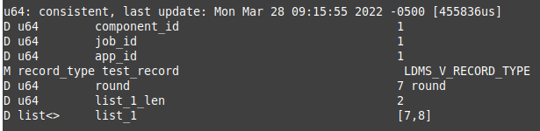
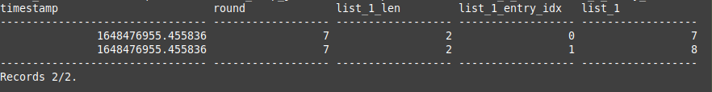
Storing lists
store_csv and store_sos store lists in multiple rows, a list entry for each row.
2 entries
2 rows

Slide 27
Storing lists
store_csv and store_sos store lists in multiple rows, a list entry for each row.
The timestamp and the primitive metrics are repeated on each row.

Slide 28
Storing lists
store_csv and store_sos store lists in multiple rows: list entry for each row.
The timestamp and the primitive metrics are repeated on each row.
The list entry index is stored in the <list name>_entry_idx column. The index starts at 0.

Slide 29
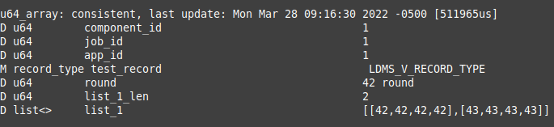
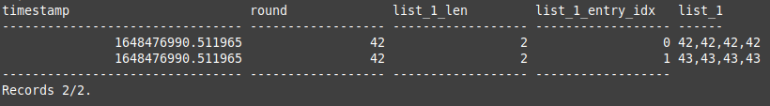
Storing lists of arrays – store_sos
store_sos stores arrays in a single column.

Slide 30


Storing lists of arrays – store_csv
store_csv stores arrays in multiple columns by default.
The column names are <list name>0, <list name>1, and so on.
Time,Time_usec,ProducerName,component_id,job_id,app_id, round,list_1_len,list_1_entry_idx,list_10,list_11,list_12,list_13
A new option was introduced to store arrays in a single column.
config name=store_csv path=/path/to/db expand_array=false
The stored values are “v1,v2,v3,...”. The column name is the list name.
Time,Time_usec,ProducerName,component_id,job_id,app_id, round,list_1_len,list_1_entry_idx,list_1

Slide 31
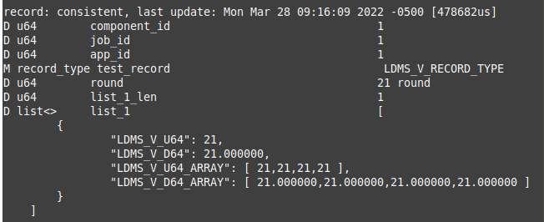
Storing lists of records
Storing records in multiple columns
Each record entry in a column
list_1 contains a record of ‘test_record’.
The record contains 4 entries: LDMS_V_U64, LDMS_V_D64, LDMS_V_U64_ARRAY, and LDMS_V_D64_ARRAY.
Record definition
Record instance in list_1

Slide 32
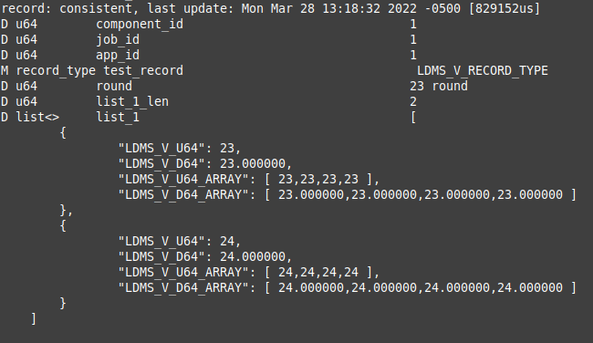
Storing lists of records
store_csv and store_sos store records in multiple columns.

Slide 33
Storing lists of records – store_sos
store_csv and store_sos store records in multiple columns.

Slide 34
Storing lists of records – store_csv
Time, Time_usec, ProducerName, component_id, job_id, app_id,

Slide 35
Storing lists of records – store_csv
Time, Time_usec, ProducerName, component_id, job_id, app_id, round, list_1_len

Slide 36
Storing lists of records – store_csv
Time, Time_usec, ProducerName, component_id, job_id, app_id, round, list_1_len, list_1_entry_idx

Slide 37
Storing lists of records – store_csv
Time, Time_usec, ProducerName, component_id, job_id, app_id, round, list_1_len, list_1_entry_idx, list_1_LDMS_V_U64, list_1_LDMS_V_D64

Slide 38
Storing lists of records – store_csv
Time, Time_usec, ProducerName, component_id, job_id, app_id, round, list_1_len, list_1_entry_idx, list_1_LDMS_V_U64, list_1_LDMS_V_D64, list_1_LDMS_V_U64_ARRAY0, list_1_LDMS_V_U64_ARRAY1, list_1_LDMS_V_U64_ARRAY2, list_1_LDMS_V_U64_ARRAY3

Slide 39
Storing lists of records – store_csv
Time, Time_usec, ProducerName, component_id, job_id, app_id, round, list_1_len, list_1_entry_idx, list_1_LDMS_V_U64, list_1_LDMS_V_D64, list_1_LDMS_V_U64_ARRAY0, list_1_LDMS_V_U64_ARRAY1, list_1_LDMS_V_U64_ARRAY2, list_1_LDMS_V_U64_ARRAY3, list_1_LDMS_V_D64_ARRAY0, list_1_LDMS_V_D64_ARRAY1, list_1_LDMS_V_D64_ARRAY2, list_1_LDMS_V_D64_ARRAY3

Slide 40
Storing multiple lists

Slide 41
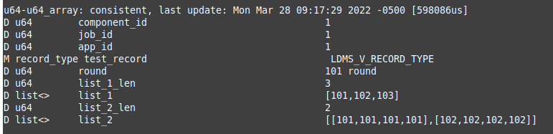
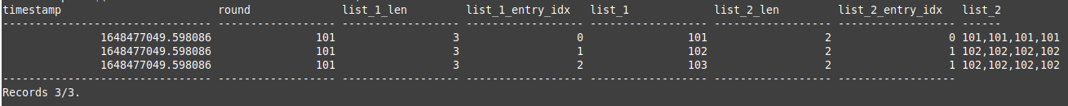
Storing multiple lists
Repeat the last entry of the shorter lists

Slide 42
Storing multiple lists
Repeat the last entry of the shorter lists

Slide 43
procstat2

Slide 44
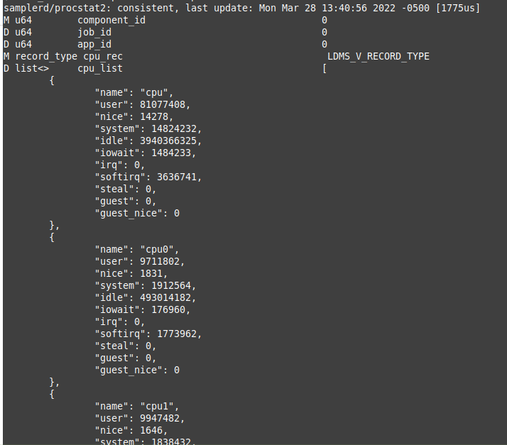
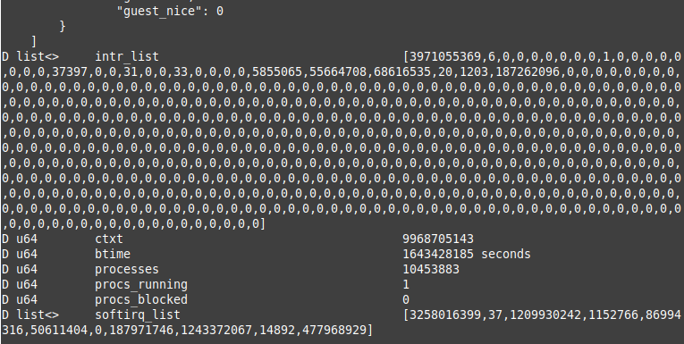
Storing procstat2
cpu_list – List of records
intr_list – list of U64
softirq_list – list of U64

Slide 45
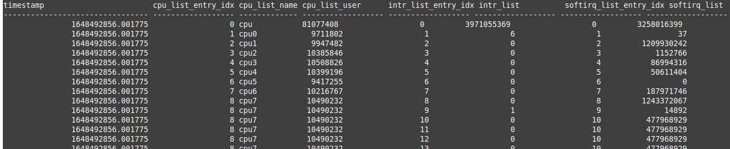
procstat2 – store_sos
cpu_list
intr_list
softirq_list

Slide 46
procstat2 – store_sos
softiirq_list’s entry_idx
cpu_list’s entry_idx
cpu_list
intr_list’s entry_idx
intr_list
softirq_list

Slide 47
procstat2 – store_sos
Last data points of cpu_list and softirq_list were repeatedly stored because the intr_list length was longer than the other two lists.

Slide 48
Thank you!

